Slide 1
DoxyPEP for STIs: Data, Questions, Controversies
Kevin L. Ard, MD, MPH
Director, Sexual Health Clinic, Massachusetts General Hospital
Assistant Professor of Medicine, Harvard Medical School
Notes:
Note that I will be focusing on a specific antibiotic (doxycycline) and on its use for PEP, since PEP has been better studied than PrEP. Because the spectrum and potential resistance impacts of antibiotics differ, a discussion about whether to use an antibiotic for PEP must be drug-specific.

Slide 2
I have no financial disclosures.

Slide 3
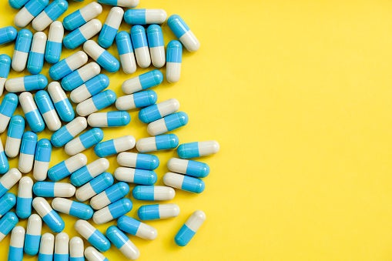
Agenda
Clinical trial data
Other data and considerations
Discussion and debate
Image from GoodRX.com

Slide 4
A case
A 32-year-old man with well-controlled HIV presents for a routine follow-up visit. He is sexually active with other men and rarely uses condoms. He is asymptomatic today and has a normal physical examination. He had pharyngeal gonorrhea 3 months ago, for which he received intramuscular ceftriaxone. Routine STI testing today is negative aside from a newly positive treponemal antibody, with an RPR of 1:16. He is treated with IM penicillin.
Would you recommend doxyPEP for STIs for him (i.e., 200 mg taken 24-72 hours after sex)?
A. Yes
B. No
C. I don’t know.

Slide 5
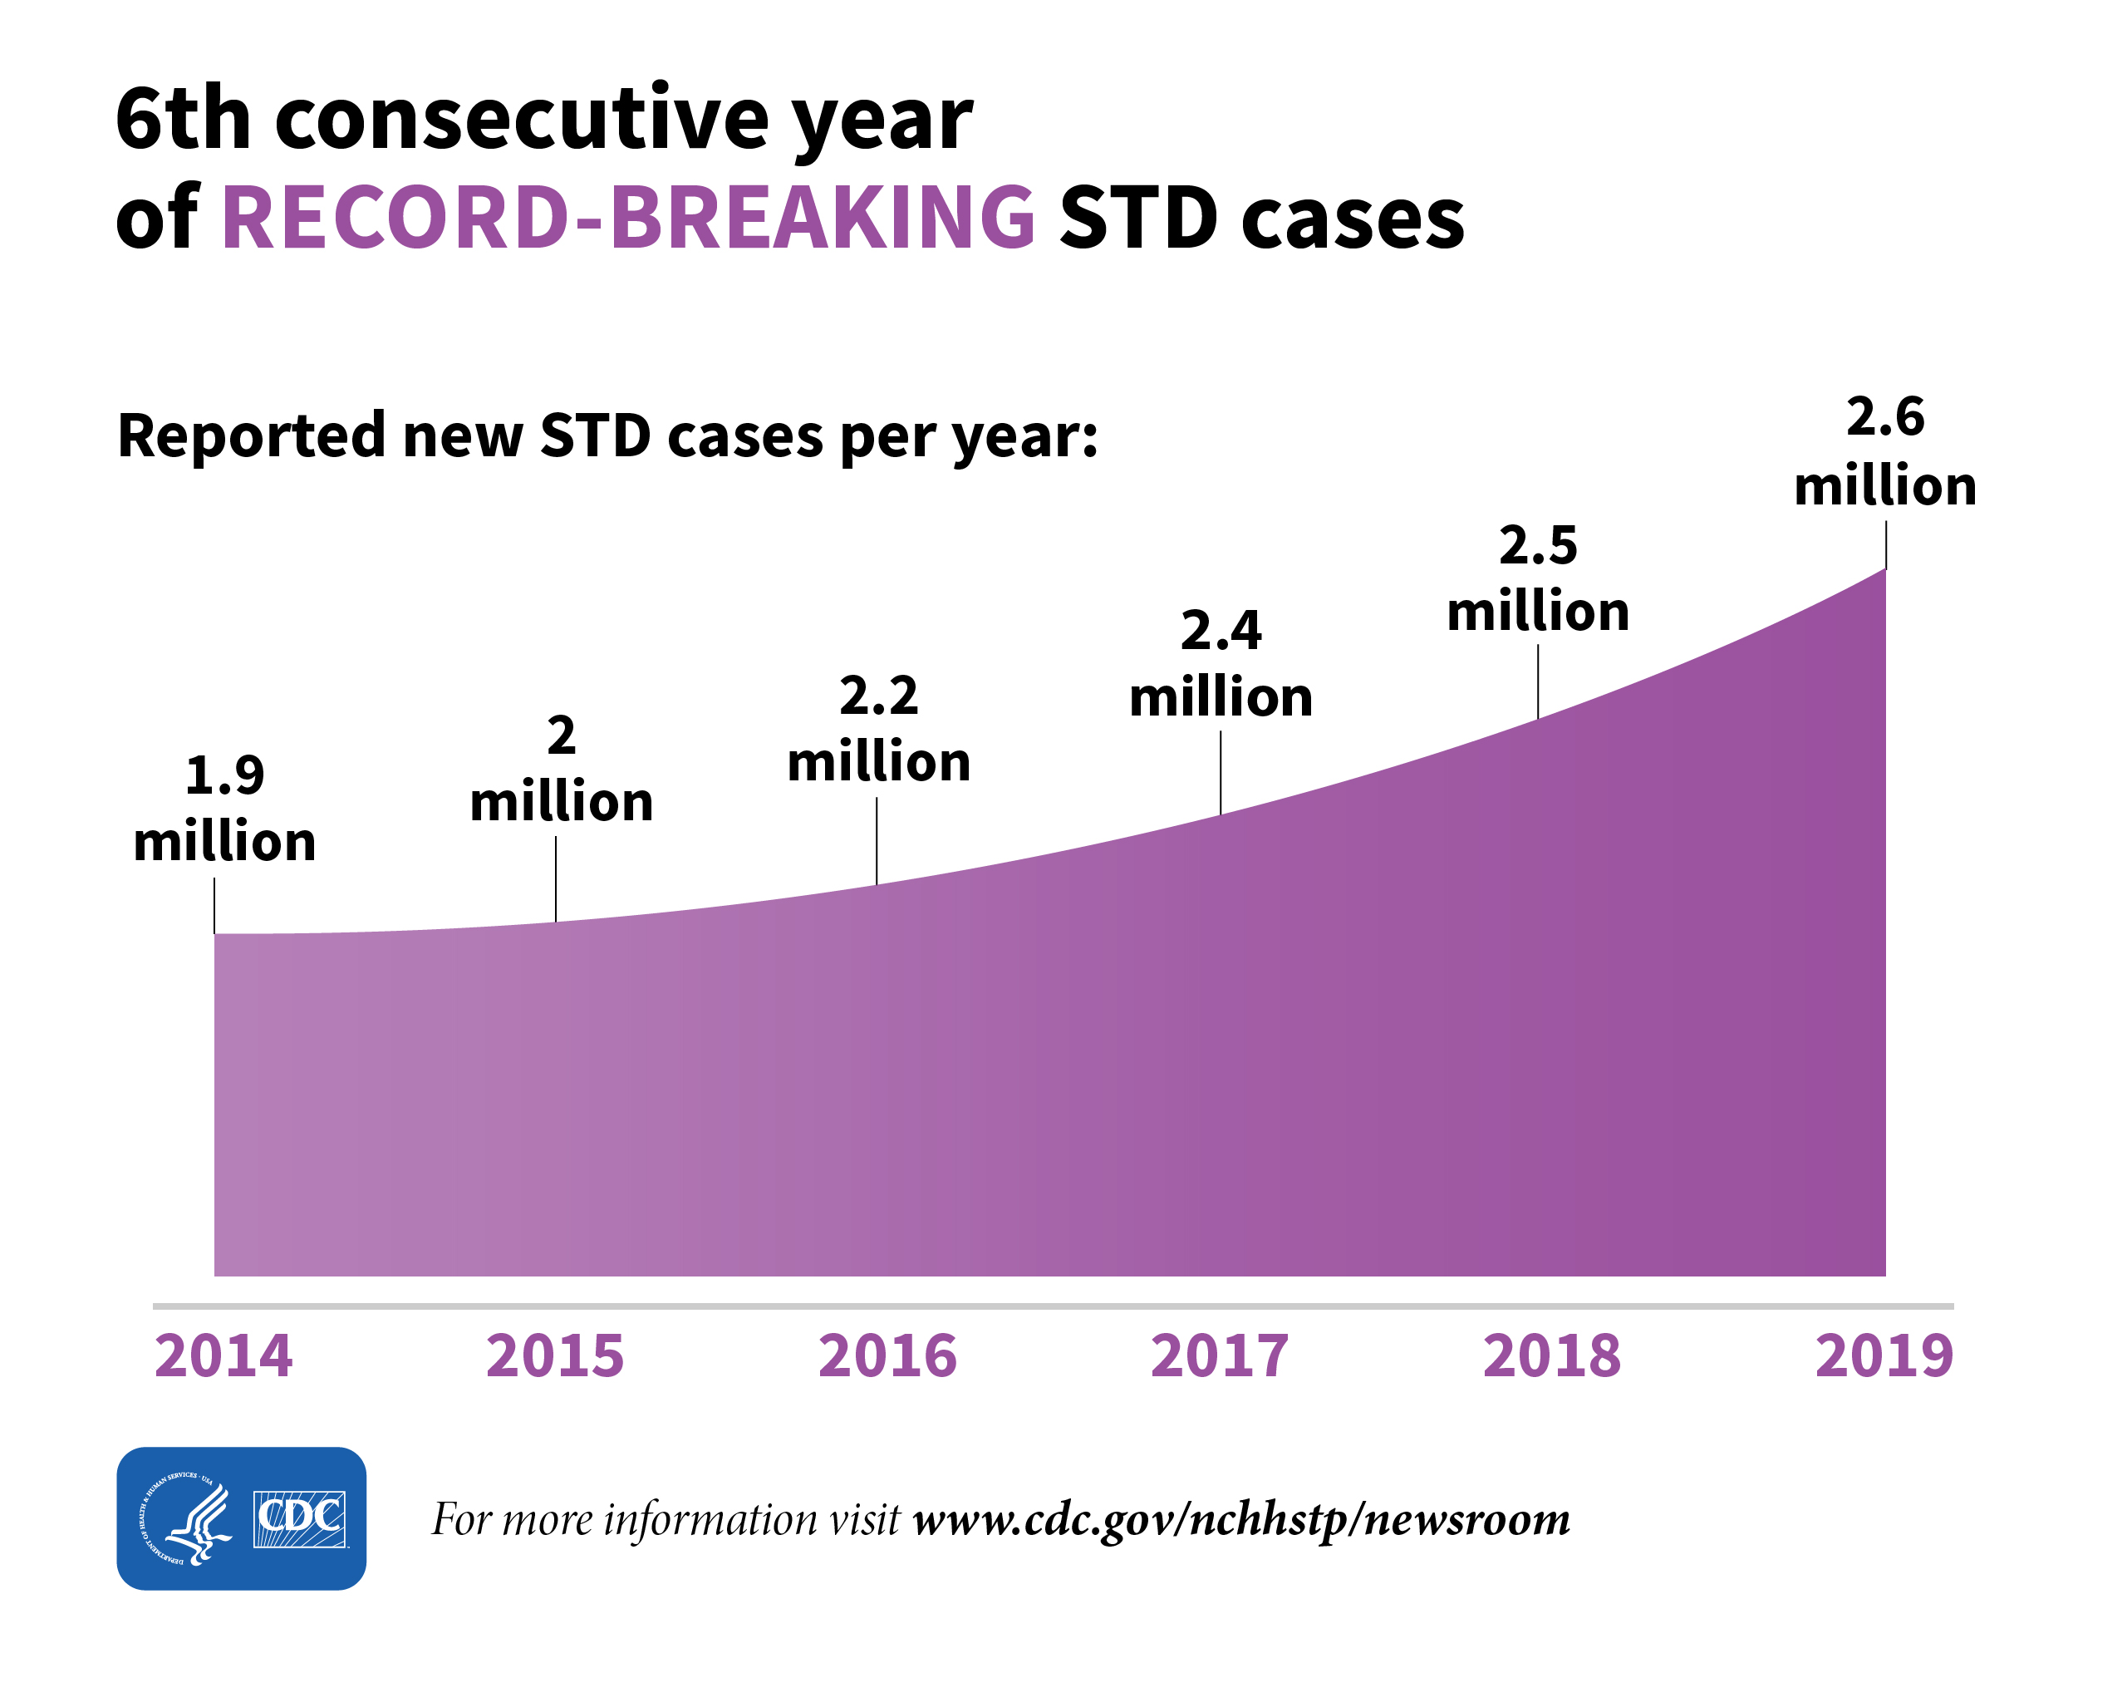
Why are we discussing doxyPEP now?
Unchecked rise in reportable STIs
Findings from a key trial (showing benefit) were presented this summer; additional data are expected at CROI.
Patients are asking about doxyPEP (and some are noting doxyPEP use on their hookup app profiles).
Some groups have already made recommendations for doxyPEP (e.g., San Francisco).
CDC has published considerations for doxyPEP.
https://www.cdc.gov/nchhstp/newsroom/2021/2019-STD-surveillance-report.html

Slide 6
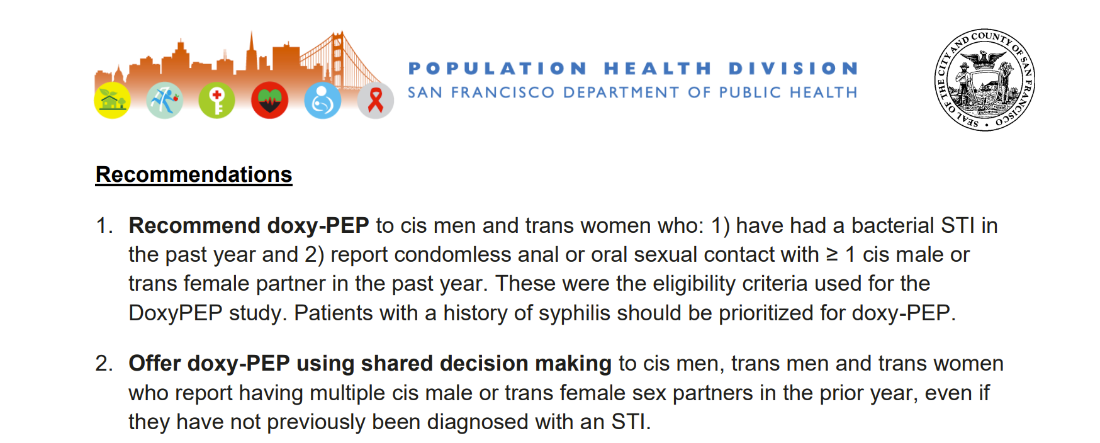
https://www.sfcdcp.org/wp-content/uploads/2022/10/Health-Update-Doxycycline-Post-Exposure-Prophylaxis-Reduces-Incidence-of-Sexually-Transmitted-Infections-SFDPH-FINAL-10.20.2022.pdf

Slide 7
Clinical trial data

Slide 8
DoxyPEP Study
Design: 2:1 randomized, open-label trial of doxycycline 200 mg within 72 hours after sex or no doxycycline
Population: MSM and transgender women either with HIV or on PrEP in San Francisco and Seattle, ≥ 1 STI in the past year, condomless sex with ≥ 1 man in the past year
Outcomes:
Primary: STI (gonorrhea, chlamydia, and syphilis) incidence, assessed quarterly and when symptomatic
Secondary: Safety; resistance within bacterial STIs, Staphylococcus aureus, and commensual Neisseria species; impact on the gut microbiome
The DSMB stopped enrollment in 5/2022 because a scheduled interim analysis showed benefit both for people taking PrEP and those with HIV.
Luetkemeyer A, AIDS 2022

Slide 9
DoxyPEP baseline characteristics
 | PrEP | Living with HIV | Total
Participants* (ITT population) | 327 | 174 | 501
Age | 36 (31 - 42) | 43 (36 - 54) | 38 (32 - 47)
Race
White | 210 (67%) | 111 (66%) | 321 (67%)
Black | 14 (5%) | 22 (13%) | 36 (8%)
Asian/Pacific Islander | 45 (14%) | 8 (5%) | 53 (11%)
Multiple races/other | 44 (14%) | 28 (17%) | 72 (15%)
Ethnicity: Hispanic/Latino | 96 (29%) | 55 (32%) | 151 (30%)
Gender identity
Man | 319 (98%) | 163 (94%) | 482 (96%)
Trans woman/gender diverse | 8(2%) | 11 (6%) | 19 (4%)
Gender of sexual partners: Male only | 281 (86%) | 153 (88%) | 434 (87%)
STI in past 12 months**
Gonorrhea | 233 (71%) | 110 (63%) | 343 (69%)
Chlamydia | 207 (63%) | 85 (49%) | 292 (58%)
Syphilis† | 48 (15%) | 52 (30%) | 100 (20%)
Sexual partners in past 3 months | 9 (4 - 17) | 8.5 (3 - 20) | 9 (4 - 17)
Substance use in past 3 months | 178 (55%) | 115 (68%) | 293 (59%)
Stimulants (methamphetamine, cocaine, crack) | 73 (23%) | 73 (43%) | 146 (30%)
Ecstasy, GHB, ketamine | 97 (30%) | 60 (35%) | 157 (32%)
Amyl Nitrates (poppers) | 140 (43%) | 84 (49%) | 224 (45%)
As of May 13, 2022
Table from Luetkemeyer A, AIDS 2022

Slide 10
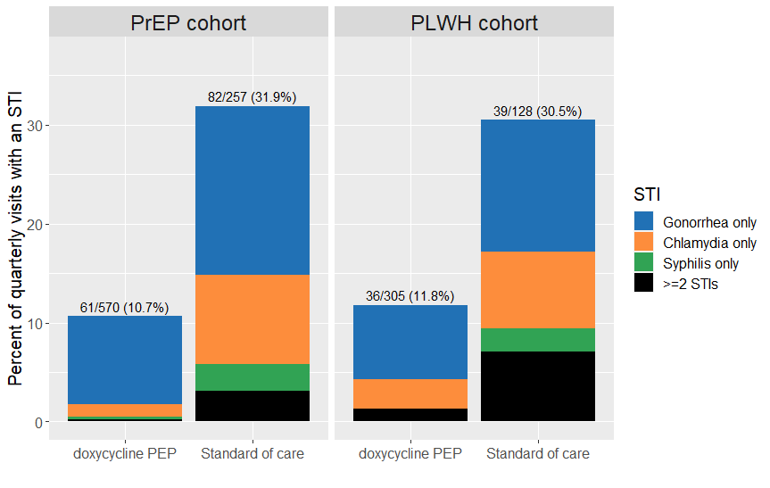
DoxyPEP reduced STI incidence per quarter.
Relative risk reductions (95% CI):
PrEP: 0.34 (0.24-0.46)
People with HIV: 0.38 (0.24-0.6)
Total: 0.35 (0.27-0.46)
All p < 0.0001
Number needed to treat ~ 5
Figure from Luetkemeyer A, AIDS 2022
Notes:
Of the STI endpoints, ~15-17% were symptomatic in the doxyPEP group, and 24-28% were symptomatic in the standard of care group.

Slide 11
DoxyPEP also reduced gonorrhea incidence.
Relative risk reduction (95% CI) of STI incidence per quarter
Sexually transmitted infection | PrEP cohort | People with HIV cohort
Gonorrhea | 0.45 (0.32-0.65) | 0.43 (0.26-0.71)
Chlamydia | 0.12 (0.05-0.25) | 0.26 (0.12-0.57)
Syphilis | 0.13 (0.03-0.59) | 0.23 (0.04-1.29)
DoxyPEP reduced ceftriaxone use by ~50%.
Table adapted from Luetkemeyer A, AIDS 2022

Slide 12
DoxyPEP safety, use, and adherence
No grade 3 adverse events, grade 2 or higher lab abnormalities, or serious adverse events
88% of participants said doxyPEP was acceptable or very acceptable.
1.5% of participants discontinued doxycycline.
Participants took doxyPEP for 87% of sexual encounters, by self report.
Median use: 4 doses per month, based on CASI
Luetkemeyer A, AIDS 2022; personal communication from Julie Dombrowski

Slide 13
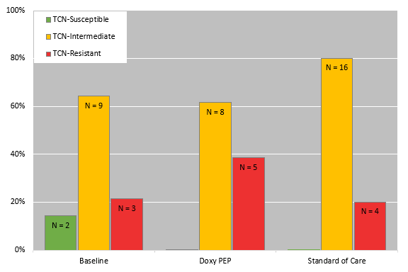
Antimicrobial resistance and microbiome effects
Tetracycline susceptibility for cultured isolates of N. gonorrhoeae
Resistance data are available for ~30% of gonococcal endpoints.
Impacts on Staphylococcus aureus, commensal Neisseria species, and the gut microbiome are not yet publicly available.
Baseline
DoxyPEP
Standard of care
Figure from Luetkemeyer A, AIDS 2022

Slide 14
Other clinical trials
ANRS Prevenir Study: 2:1 randomized, open label study of doxyPEP versus no PEP combined with a 1:1 randomized study of meningococcal type B vaccination among MSM
dPEP Study: 1:1 randomized, open label study of doxyPEP (200 mg 24-72 hours after sex) among young Kenyan women taking PrEP
Syphilaxis Study: Non-randomized single arm trial with before-after comparison of doxycycline 100 mg daily among MSM and transgender people
DISCO Study: 1:1:1 randomized, open label study of doxycycline 100 mg daily, doxycycline 200 mg within 72 hours of condomless sex, and standard of care among MSM
Stewart J, Trials, 2022; Grant JS, Clin Infect Dis, 2020

Slide 15
Other data and considerations

Slide 16
Our world is awash in tetracyclines.
https://www.cdc.gov/antibiotic-use/pdfs/Annual-Report-2020-H.pdf

Slide 17
Agricultural uses of tetracyclines dwarf human uses.
Antimicrobial sale and distribution data for food-producing animals, by drug class
https://www.fda.gov/media/102160/download

Slide 18
Antimicrobial resistance considerations
Sexually transmitted pathogens
Chlamydia trachomatis and Treponema pallidum = Low likelihood of doxycycline resistance
Neisseria gonorrhoeae = Higher likelihood of doxycycline resistance
DoxyPEP impact on gonorrhea may not be durable
Might doxycycline select for organisms with other antimicrobial resistance?
Does this matter?
Mycoplasma genitalium
Efficacy of doxycycline alone against M. genitalium is low
Doxycycline is a component of the sequential treatment strategies recommended in the U.S.
Other pathogens
Staphylococcus aureus
Cehovin A, J Infect Dis, 2018; Grant JS, Clin Infect Dis, 2020; 2021 STI Treatment Guidelines

Slide 19
Microbiome considerations
Microbiome perturbations associated with obesity and other chronic diseases
Microbiome data from doxyPEP studies may not be useful in the short term:
We don’t know how to counsel patients about specific microbiome changes.
Comparing microbiomes of people who received doxyPEP versus intermittent doxycycline, ceftriaxone, penicillin, etc.
Doxycycline is one of the least C. difficile-promoting antibacterials (OR 0.91 in a meta-analysis).
https://atlasbiomed.com/blog/7-crazy-facts-about-the-microbiome-and-gut-bacteria/; Cox LM, Nat Rev Endocrinol, 2015; Desphande A, J Antimicrob Chemother, 2013

Slide 20
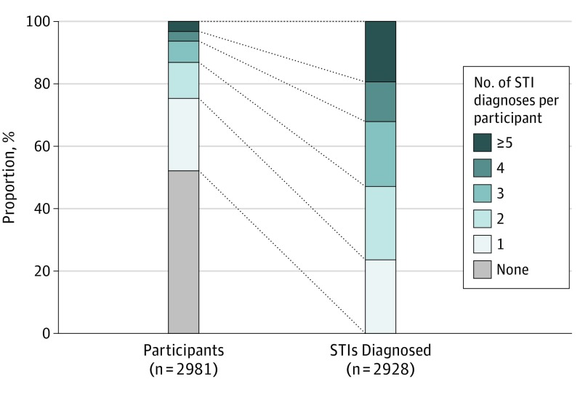
Among PrEP users, a small proportion of people acquire a majority of STIs.
Among a cohort of 2,981 MSM taking PrEP in Australia, 25% of participants accounted for 76% of all STIs.
STIs associated with:
More anal sex partners
Group sex
Traeger MW, JAMA, 2019

Slide 21
Clinicians and patients may prioritize different benefits of doxyPEP.
Clinicians and public health workers: STI control, morbidity reduction
Patients: Reduced stigma, decreased anxiety around sex, avoidance of relationship impacts and the inconvenience of obtaining treatment
Interest in doxyPEP is high among MSM: 84% were interested in an online survey, with higher interest among Black and Latinx MSM
Community member: “This feels like the beginning of PrEP and U=U all over again. The community is ready, but doctors are reluctant.”
Spinelli MA, Sex Transm Dis, 2020

Slide 22
Many implementation questions
For which patients should doxyPEP be recommended?
What are key components of shared decision-making for doxyPEP?
How should STI exposures be handled among people taking doxyPEP?
What is the optimal frequency of STI testing among people taking doxyPEP?
How many pills should be prescribed at one time?
How can access and uptake be as equitable as possible?

Slide 23
My perspective
Offer doxyPEP to MSM and transgender women with an STI or multiple condomless sex partners in the past year (include cisgender women depending on the results of the dPEP study).
Use a shared decision-making approach, potentially with tools developed for this purpose.
Continue every-three-month STI screening for now.
For patients taking doxyPEP, do not treat empirically for asymptomatic exposure to gonorrhea or chlamydia.
Prescribe 30 pills at a time.
Image from https://www.poison.org/articles/what-is-doxycycline

Slide 24
Discussion and debate

Slide 25
A case
A 32-year-old man with well-controlled HIV presents for a routine follow-up visit. He is sexually active with other men and rarely uses condoms. He is asymptomatic today and has a normal physical examination. He had pharyngeal gonorrhea 3 months ago, for which he received intramuscular ceftriaxone. Routine STI testing today is negative aside from a newly positive treponemal antibody, with an RPR of 1:16. He is treated with IM penicillin.
Would you recommend doxyPEP for STIs for him (i.e., 200 mg taken 24-72 hours after sex)?
A. Yes
B. No
C. I don’t know.

Slide 26
Summary
200 mg of doxycycline given 24-72 hours (doxyPEP) after sex reduces incidence of chlamydia, syphilis, and possibly gonorrhea among MSM and transgender women who have sex with men.
This strategy is generally well-tolerated.
Impacts on antimicrobial resistance and the microbiome are poorly understood.
DoxyPEP is of increasing interest to many people at risk for STIs.

