Slide 1
Doxy PEP Implementation
The Ratelle’s A1 Team
June 13,2023

Slide 2
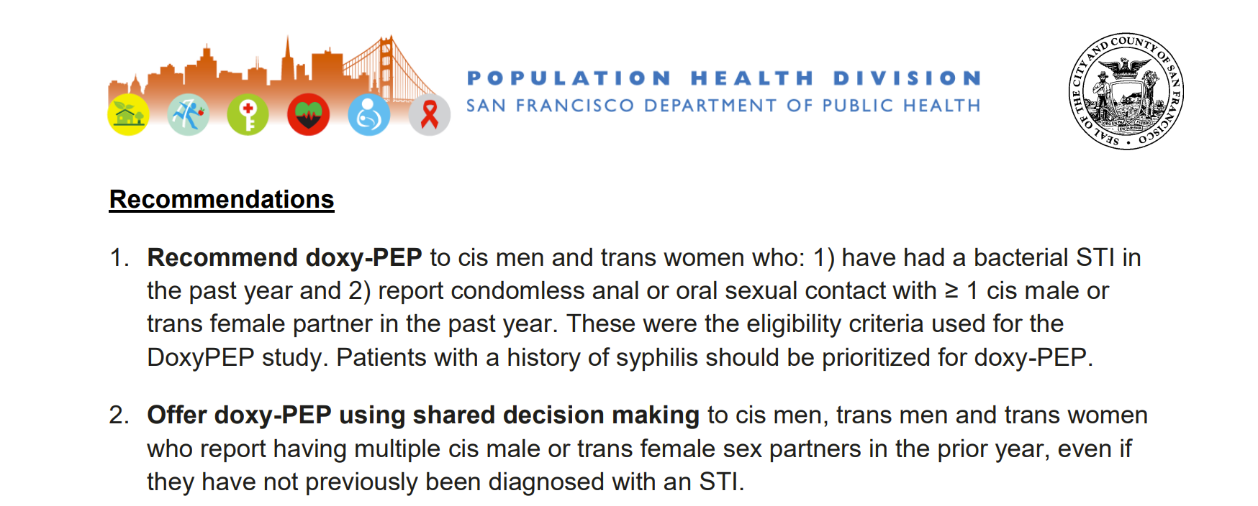
https://www.sfcdcp.org/wp-content/uploads/2022/10/Health-Update-Doxycycline-Post-Exposure-Prophylaxis-Reduces-Incidence-of-Sexually-Transmitted-Infections-SFDPH-FINAL-10.20.2022.pdf

Slide 3
Who are doxyPEP candidates?
With whom should doxyPEP be discussed?
Should we offer it only, or should we recommend it for certain patients?
Should we consider doxyPEP for people who have not been included in any trials to date (e.g., men who have sex with women only)?
Does doxyPEP make sense for people who do not have HIV but who also do not want to take PrEP?

Slide 4
What information should be included in a discussion with patients about doxyPEP?
What should shared decision-making with patients look like?
What should be included in the conversation?
Should we develop shared decision-making materials such as exist for other scenarios (e.g., prostate cancer screening)?
Will there be handouts/patient friendly literature to review and give to patients explaining the purpose, dosage and administration of Doxy PEP

Slide 5
How should doxyPEP be prescribed?
How many pills should we give people at one time?
How many refills?
How should patients take it if they have ongoing, daily exposures?
Doxycycline monohydrate vs hyclate - is one preferred over the other

Slide 6
Management of people taking doxyPEP
How often should follow-up and STI screening be performed?
How should we manage confirmed exposures to STIs in people taking doxyPEP?
Does this vary by the exposure (chlamydia versus gonorrhea versus syphilis)?

Slide 7
Barriers
Awareness of doxyPEP – across patients, providers, staff
Concerns for development of antibiotic resistance

Slide 8
Final thought

