Slide 1
Connecticut Department of Public Health Laboratory STD Testing Services
Christina Langer
Supervising Microbiologist, Virology/Serology/STDs
Dr. Katherine A. Kelley State Public Health Laboratory
Connecticut Department of Public Health
395 West Street
Rocky Hill, CT 06067
christina.langer@ct.gov
Ph: 860-920-6647, Fax: 860-920-6661

Slide 2
Virology/Serology/STDs Laboratory Section Phone: 860-920-6662 Fax: 860-920-6661
Chlamydia/Gonorrhea
Syphilis
Herpes
HIV
Hepatitis B & C
*Trichomonas Vaginalis testing is NOT available at this time*

Slide 3
Please fill out a completed Clinical Test Requisition, Form OL-9B, for each Specimen Source/Type submitted.

Slide 4
Current Testing CT DPH LAB Chlamydia & Gonorrhea Testing
Test Description: Qualitative detection and differentiation of ribosomal RNA (rRNA) from Chlamydia trachomatis and/or Neisseria gonorrhoeae in genital, extra genital and urine specimens.
Methodology: Target amplification nucleic acid probe test (Aptima Combo 2 on the Panther System)
Intended Use: As an aid in the diagnosis of chlamydial and gonococcal diseases in symptomatic or asymptomatic individuals.
Specimen Types:
Vaginal, Throat & Rectal Swabs (Aptima Multitest Swab Specimen Collection Kit)
Endocervical and Male Urethral Swabs (Aptima Unisex Swab Specimen Collection Kit)
Urine (Aptima Urine Specimen Collection Kit)
Specimen Storage: Store collected specimen tubes between 4°C to 30°C. Urine samples must be tested within 30 days. Swab specimens must be tested within 60 days.
Collection Instructions: Follow instructions provided with each specific collection kit.
Rectal, throat, endocervical & male urethral swabs: clinician-collected ONLY. Vaginal swabs: clinician-collected OR patient-collected (not for home use).
Specimen must be collected before the expiration date on the collection kit.

Slide 5
Current Testing CT DPH LAB Syphilis Testing- Screen & Confirmation
Test Description: Non-treponemal assay for the detection of reagin in serum. Reactive results are tittered to end point and confirmed with a treponemal-specific test
Methodology: VDRL (Venereal Disease Research Laboratory) Slide Flocculation Test
Intended Use: Serologic screen to aid in the diagnosis of primary, secondary or tertiary syphilis and for post-treatment evaluation.
CSF – To rule out neurosyphilis in patients with neurological symptoms.
Specimen Types: Serum, Cerebrospinal fluid (CSF)
Specimen Storage: Store at 2-8°C. Specimens must be received within 5 days of collection.

Slide 6
Current Testing CT DPH LAB Syphilis Testing- Screen & Confirmation
Test Description: Detection of Treponema pallidum antibodies in human serum or plasma.
Methodology: Treponema pallidum Particle Agglutination Assay (TP-PA)
Intended Use: To confirm reactive results of non-treponemal syphilis screening (such as VDRL or RPR); as a diagnostic test in individuals with a nonreactive non-treponemal test result but with symptoms suggestive of late syphilis.
Specimen Types: Serum, Plasma
Specimen Storage: Store at 2-8°C. Specimens must be received within 5 days of collection.

Slide 7
Current Testing CT DPH LAB Herpes Simple Virus (HSV) DNA Testing
Test Description: Qualitative assay for the detection of Herpes simplex virus 1 and 2 DNA in human specimens.
Methodology: Loop-mediated amplification and detection.
Intended Use: Direct detection and differentiation of herpes simplex virus 1 and 2 to aid in the diagnosis of infection.
Specimen Types: Cutaneous or mucocutaneous lesion swab submitted in viral transport media, 1-3 mL.
Specimen Storage: Store at 2-8°C. Specimens must be received and tested within 7 days of collection.

Slide 8
Current Testing CT DPH LAB Herpes Simplex Virus IgG Antibody Testing
Test Description: Qualitative assay for the detection of IgG antibodies to herpes simplex virus (HSV) type 1 and type 2 in human serum. This test does not differentiate between type 1 or type 2.
Methodology: Enzyme immunoassay (EIA)
Intended Use: As an indication of past infection with herpes simplex virus to identify asymptomatic carriers.
Specimen Types: Serum
Specimen Storage: Store at 2-8°C. Specimens must be received within 2 days of collection.

Slide 9
Current Testing CT DPH LAB HIV/Hepatitis Testing
HIV 1/2 Antibody/Antigen Enzyme Immunoassay (EIA)
HIV 1 & 2 Antibody Differentiation Assay (BioRad Geenius)
HIV-1 RNA Viral Load (plasma only)
Hepatitis C Antibody Enzyme Immunoassay (EIA)
Hepatitis C RNA Viral Load (serum and plasma)
Hepatitis B Surface Antibody Enzyme Immunoassay (EIA)
Hepatitis B Surface Antigen Enzyme Immunoassay (EIA)

Slide 10
State of Connecticut Department of Public Health State Public Health Laboratory Website
Laboratory Resources:
Collection Supplies and Test Requisition Forms
https://portal.ct.gov/DPH/Laboratory/Scientific-Support/Scientific-Support-Services
Collection supplies may be requested by calling Scientific Support Services at 860-920-6674 for by submitting an email request to dph.outfitroom@ct.gov
Directory of Clinical Testing Services
https://portal.ct.gov/DPH/Laboratory/Clinical-Testing-Services/DCTS-101915

Slide 11
What Happens at the Lab
Sample Receiving Area
Sample Evaluation
Requisition Evaluation
Accessioning & Data Entry in LIS
Delivery to Laboratory for Testing
Testing Laboratory
Specimen: checked for proper labeling (name on tube must match name on test requisition), volume, proper collection tube for sample type & tube outdate (CT/GC). Serum is aliquoted into transfer tubes and frozen.
Requisitions checked for errors and omissions.

Slide 12
Testing Laboratory Activity
Testing, Reporting and Checking Results for Accuracy.
Quality Assurance Report sent out for test requests with sample or requisition inconsistencies and omissions.
Testing Not Performed if specimen unlabeled, no specimen or inadequate specimen in tube, wrong collection kit for sample type collected, broken or leaking.
Positive results:
Syphilis VDRL reactive and TPPA reactive results called to submitter
All positive HIV results called to submitter
CT/GC, Herpes, Hepatitis positive results not called out unless a quality assurance issue needs to be resolved.

Slide 13
Syphilis Serology
The diagnosis of syphilis infection still relies on both clinical evaluation and one of two multitest laboratory testing algorithms to indicate current or past infection with Treponema pallidum.
Two types of serological Syphilis tests:
Treponemal assays – detect antibodies to T. pallidum.
Treponemal tests include either IgM, IgG or total (IgG/IgM) antibodies. Antibodies detected by treponemal tests arise earlier than those detected by non-treponemal tests and typically remain detectable for life, even after successful treatment.
Nontreponemal assays – detect antibodies (IgG/IgM) directed against lipoidal antigens (cardiolipin, cholesterol and lecithin), released as a consequence of cell damage, which is elevated in numerous chronic conditions and infections including syphilis.
Nontreponemal tests can provide an end point titer for positive samples. Titers decline after proper treatment over a period of months to years.

Slide 14
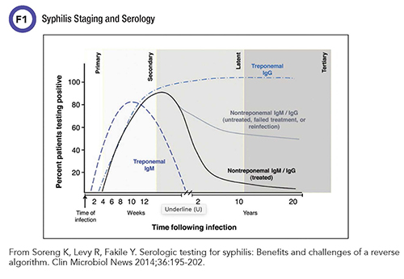

Slide 15
Association of Public Health Laboratories. Suggested Reporting Language for Syphilis Serological Testing-2nd Edition. August 2020

Slide 16
Traditional Syphilis Serology Testing Algorithm
Association of Public Health Laboratories. Suggested Reporting Language for Syphilis Serological Testing-2nd Edition. August 2020

Slide 17
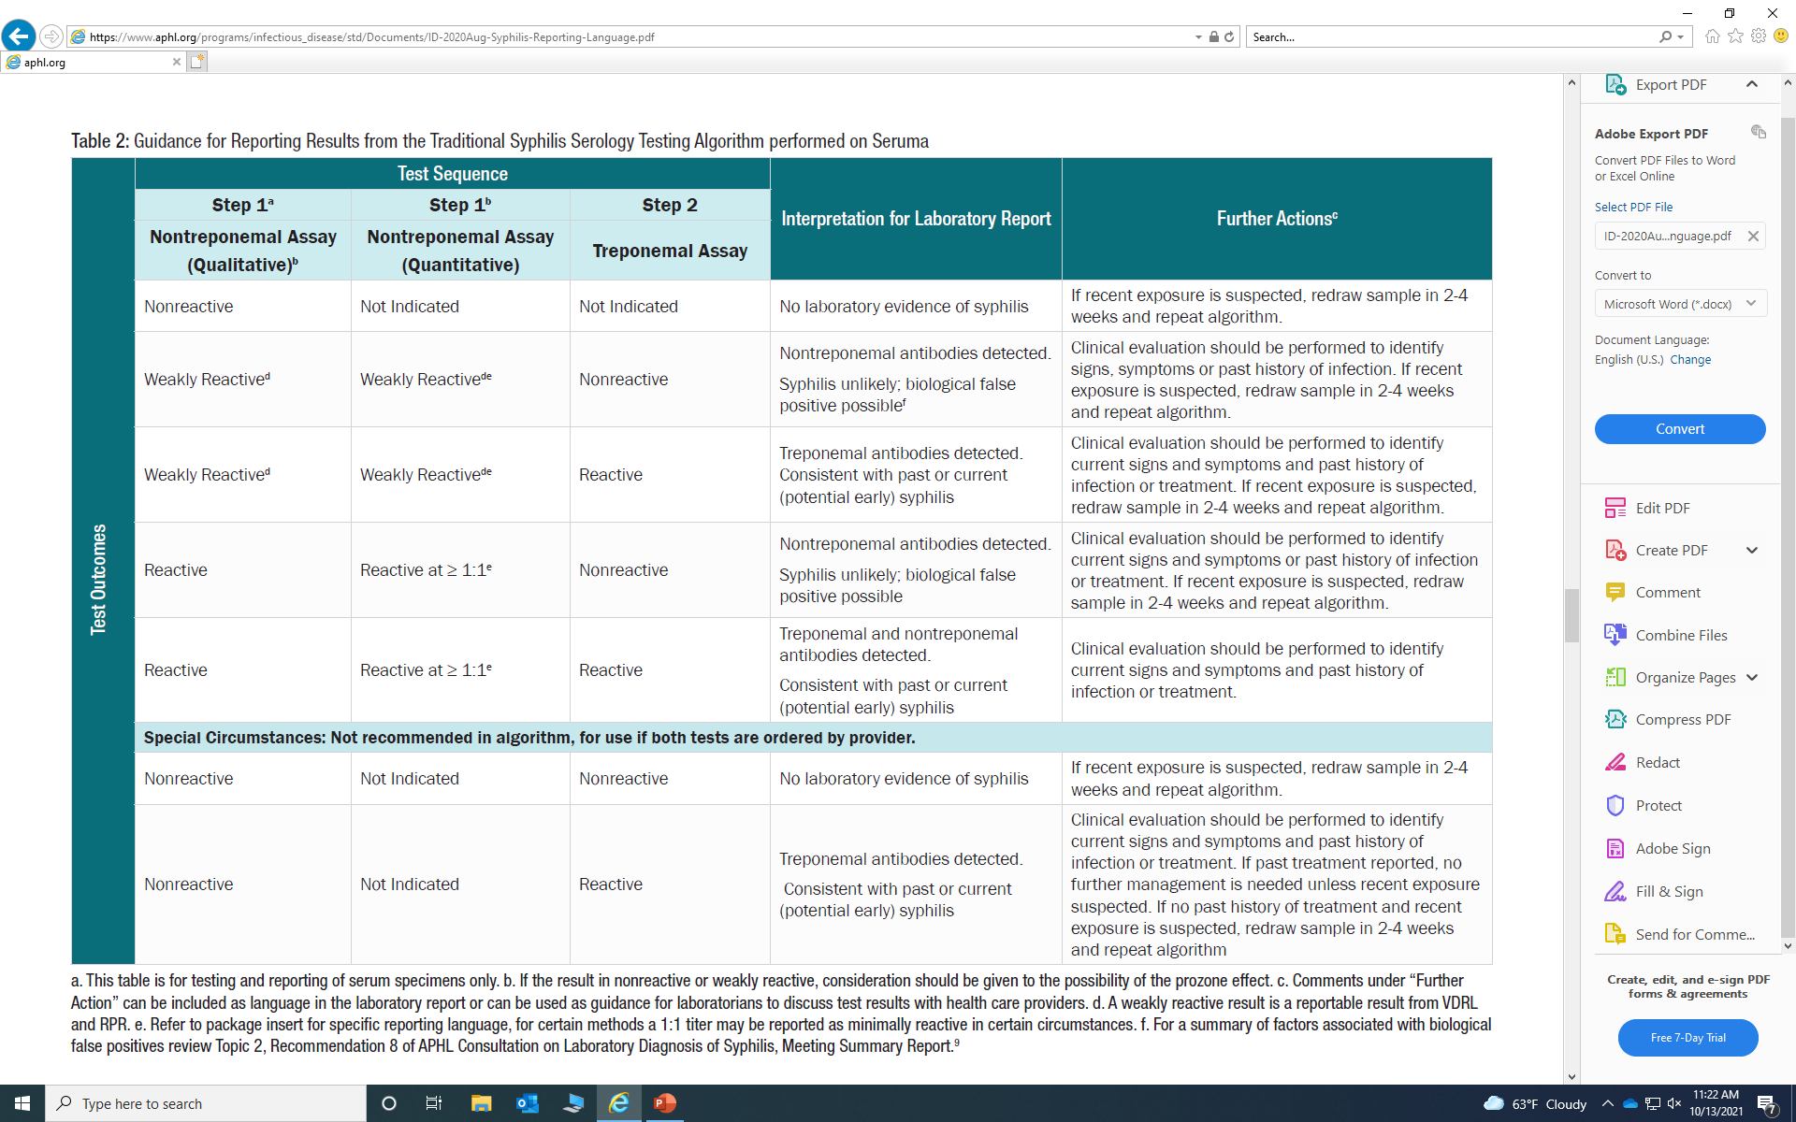
Association of Public Health Laboratories. Suggested Reporting Language for Syphilis Serological Testing-2nd Edition. August 2020

Slide 18
Reverse Syphilis Serology Testing Algorithm
Association of Public Health Laboratories. Suggested Reporting Language for Syphilis Serological Testing-2nd Edition. August 2020

Slide 19
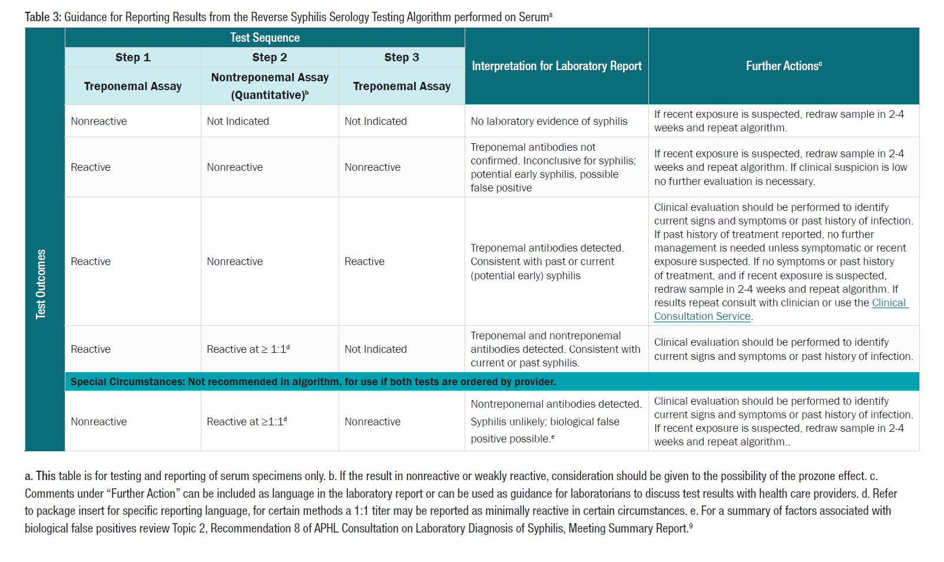
Association of Public Health Laboratories. Suggested Reporting Language for Syphilis Serological Testing-2nd Edition. August 2020

Slide 20
Advantages of a Reverse Syphilis Test Algorithm
Advantages of screening with a Treponemal IgM/IgG Immunoassay:
Specific to Syphilis, nontreponemal assays are relatively nonspecific.
More sensitive then nontreponemal assays for detecting primary and late latent syphilis.
Available on automated instruments, less labor intensive.
Potential for quicker turn-around-time.

Slide 21
Upcoming Changes to STD Testing Services at the CT DPH Lab
Purchase and Implementation of the Bio-Rad BioPlex 2200 System
Assays we will be implementing on the new system include:
BioPlex 2200 Syphilis Total & RPR Assay
BioPlex 2200 HIV Ag-Ab Assay
BioPlex 2200 HSV-1 & HSV 2 IgG Assay

Slide 22
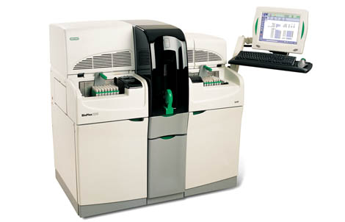
The BioPlex 2200 System is a fully-automated, random access, multiplex testing platform for the clinical diagnostic assays.

Slide 23
BioPlex 2200 Syphilis Total & RPR Assay
Intended Use: The BioPlex 2200 Syphilis Total & RPR Assay is a multiplex flow immunoassay utilizing sets of coated magnetic beads, intended for the qualitative detection of total (IgG/IgM) antibodies to Treponema pallidum and the qualitative detection and/or titer determination of non-treponemal reagin antibodies in human serum or plasma.
It is a dual assay that simultaneously detects and differentiates antibodies to T. pallidum and reagin antibodies produced during syphilis infection.
Automates RPR titers up to 1:2,048

Slide 24
BioPlex 2200 Syphilis Total & RPR Assay Limitations and Considerations
Validated sample types include serum and plasma.
The CT DPH Lab will need to retain the Syphilis VDRL assay for testing of cerebrospinal fluid (CSF) samples.
The performance of the BioPlex 2200 Syphilis Total & RPR Assay has not been established on neonates or individuals younger than 7 years old.
The CT DPH Lab will need to retain the Syphilis VDRL assay for testing infants.
It is not recommended to compare BioPlex RPR assay endpoint titers to those generated by manual methods since the manual tests are highly subjective. Higher discrepancy would be observed for cutoff/borderline/weak positive samples.
When assessing the response to Syphilis treatment, it is recommended to use the same test methodology when comparing titers.

Slide 25
Anticipated Reverse Syphilis Test Algorithm at CT DPH Laboratory
Syphilis Ab w/reflex RPR, serum/plasma only
T. pallidum total antibody (TPA) screen
Reactive/Equivocal
Nonreactive
No laboratory evidence of syphilis.
RPR w/titer
Reactive
Treponemal and nontreponemal antibodies detected. Consistent with current or past syphilis.
Nonreactive
T. Pallidum particle agglutination (TP-PA)
Reactive
Treponemal antibodies detected. Consistent with past or current (potential early) syphilis.
Nonreactive
Treponemal antibodies not confirmed. Inconclusive for syphilis; potential for early syphilis, possible false positive.

Slide 26
Anticipated HIV and HSV Test Changes
The Bioplex 2200 HIV Ag-Ab assay will replace the BioRad GS HIV Combo Ag/Ab EIA as the screening test used for the CDC Recommended HIV Testing Algorithm.
Reports out individual HIV analytes (HIV-1 Ab, HIV-2 Ab and HIV-1 p24 Ag). Supplemental testing will still be performed.
The Bioplex 2200 HSV-1 & HSV-2 IgG assay will replace the current HSV IgG EIA.
Provides qualitative detection and differentiation of IgG antibodies to HSV-1 & HSV-2.

Slide 27
Next Steps for BioPlex 2200 Testing
Installation of the BioPlex 2200 - early November 2021
Training of staff and validation of BioPlex 2200 assays
SOPs-created and approved by management/QA
LIMS- Acodes created and tested
Test Requisition updated
Directory of Clinical Testing Services – written for each assay and website updated.
Specimen storage requirements for BioPlex 2200 assays (Syphilis Total & RPR, HIV Ag-Ab, HSV-1 & HSV-2 IgG): serum stored at 2- 8°C for up to 7 days.
*Anticipated “go live” date for new testing in 3 to 4 months.*

Slide 28
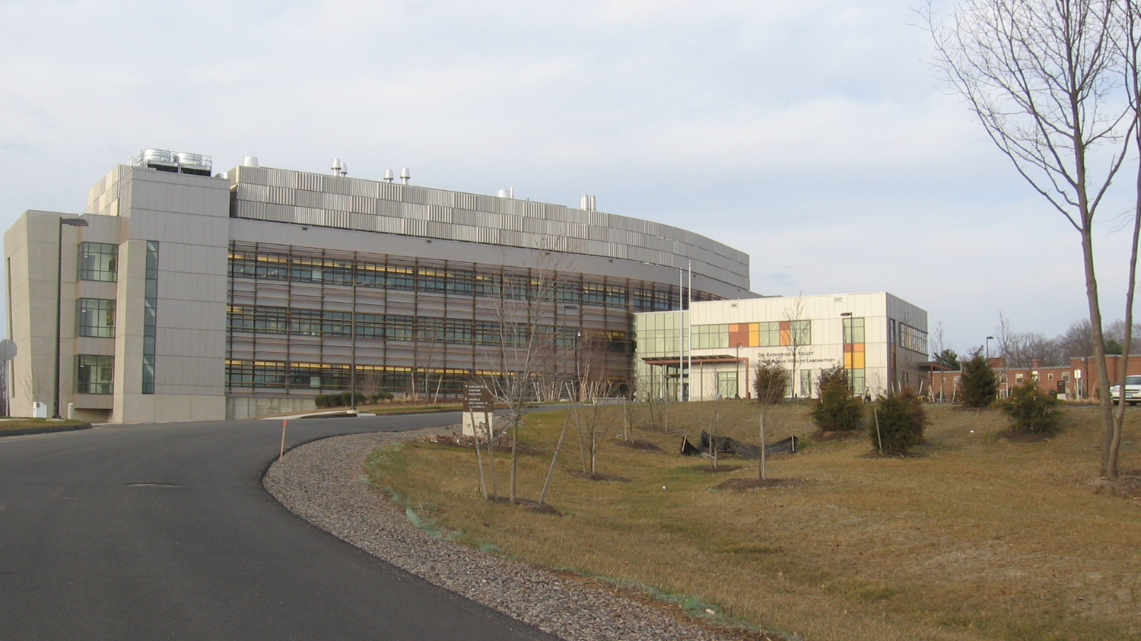
Christina Langer
Supervising Microbiologist, Virology/Serology/STDs
Dr. Katherine A. Kelley State Public Health Laboratory
Connecticut Department of Public Health
395 West Street
Rocky Hill, CT 06067
christina.langer@ct.gov
Ph: 860-920-6647, Fax: 860-920-6661

